Slide 1
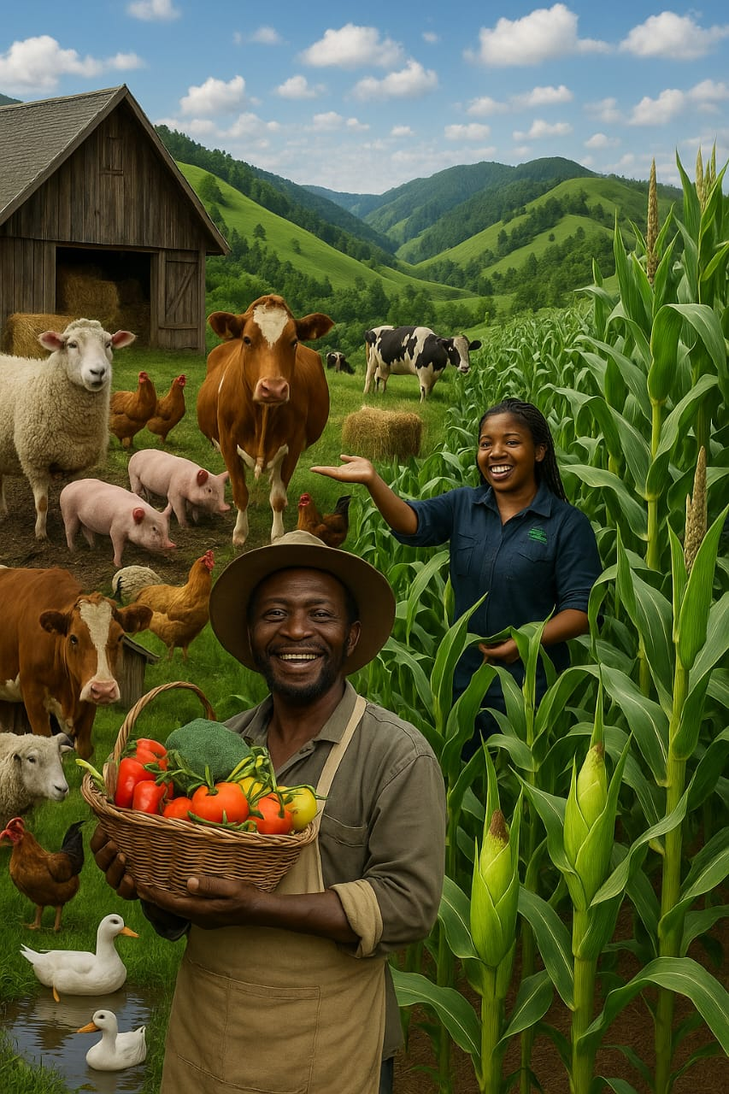
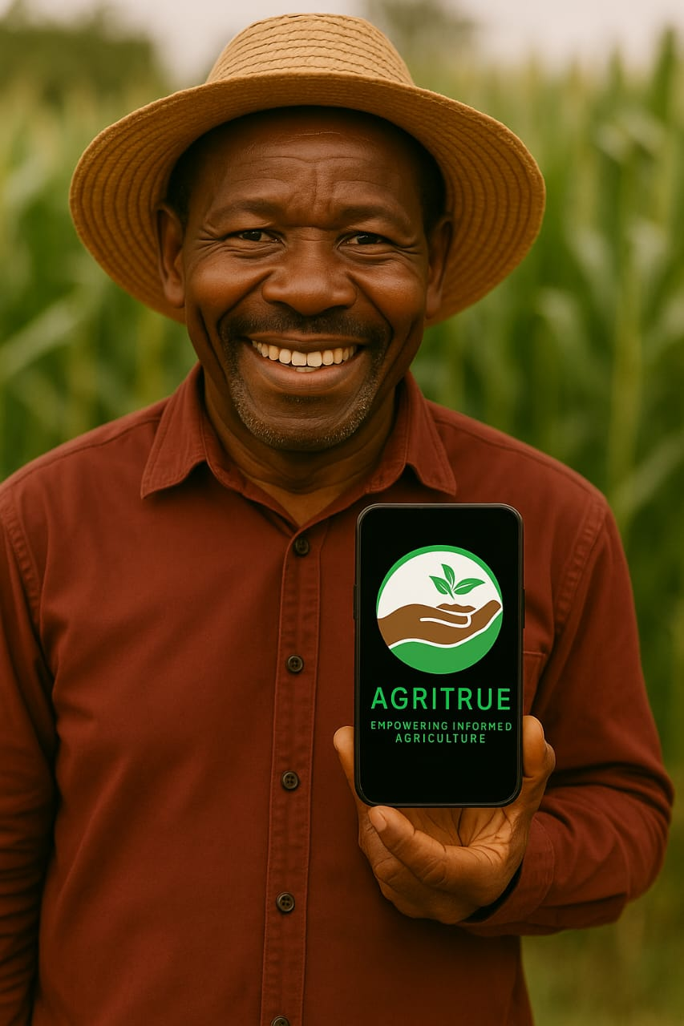

AgriTrue: Empowering informed agriculture using AI and the community.
COMBATTING MISINFORMATION & DISINFORMATION IN AGRICULTURE

Slide 2
Problem Statement
Misinformation in agriculture, especially through video content, misleads farmers, stifles innovation, and erodes public trust.
For example, in Kenya, a government-issued fertilizer scandal in 2024 exposed how low-quality inputs were distributed to farmers, leading to massive losses. Videos and conflicting reports created confusion, and no system was in place to verify authenticity.
60% of disinformation campaigns in Africa are foreign state-sponsored (Africa Center for Strategic Studies, 2024).
IMPACT OF THE PROBLEM
Farmers adopt unsafe or unproven practices.
Rejection of innovations like GMOs and modern irrigation.
Public trust in research and policy erodes.
Policy-makers struggle to combat viral falsehoods.
Kenya’s 2024 fertilizer scandal spread rapidly through unverified media, compounding farmers' confusion and reducing trust in official Agri programs.
Need: A fast, accessible way to verify the credibility of agricultural video content.
How can farmers survive when they can’t trust what they see?

Slide 3
Our game-changing Solution
AgriTrue:
An AI-powered platform that detects and corrects misinformation in agriculture.
Features:
ML-powered file analysis (images, videos, documents)
It flags potential misinformation by Analyzing photos, videos, csv files and pdfs uploaded by farmers, receiving real time recommendations to boost yields & productivity.
Community Notes for collaborative truth-checking
It allows experienced farmers, experts to add context to upvote/downvote a post.
Accessible on mobile, web, and USSD (in local languages)
It enables accessibility to rural farmers giving truth in 60 seconds.
AI Chatbot
Available 24/7 to assist farmers with their day to day agricultural queries.

Slide 4
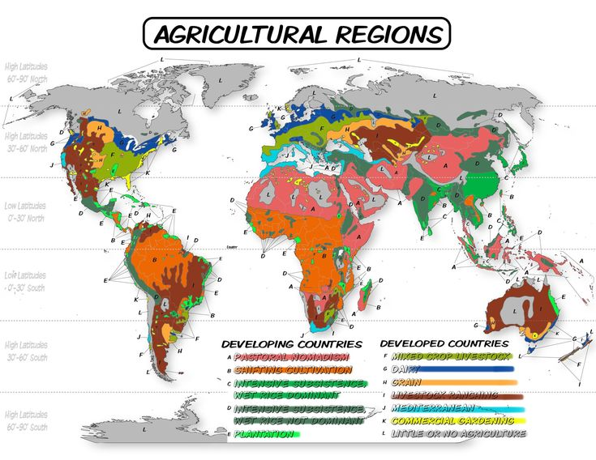
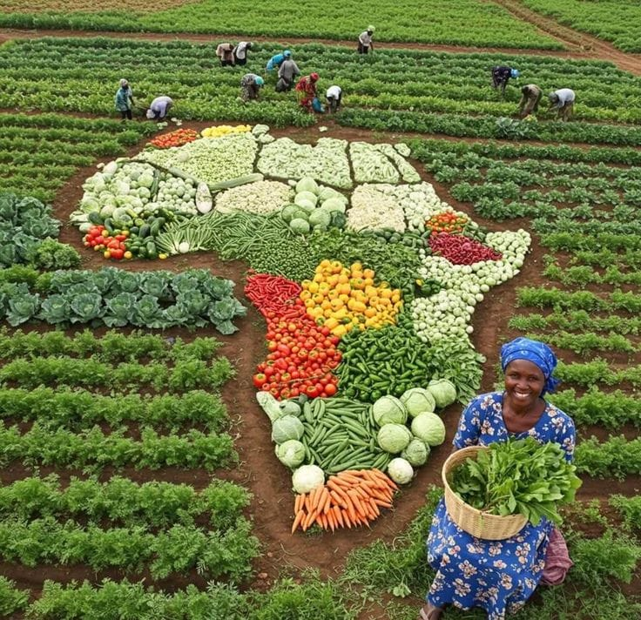
Our game-changing Solution
Farm Truth
Analyzes agricultural data to generate detailed reports on farm outputs, and other critical farming metrics empowering farmers to make informed decisions.
Know Your Land
Helps Farmers understand their land by providing deep insights on soil types, crop performance and localized weather patterns.

Slide 5
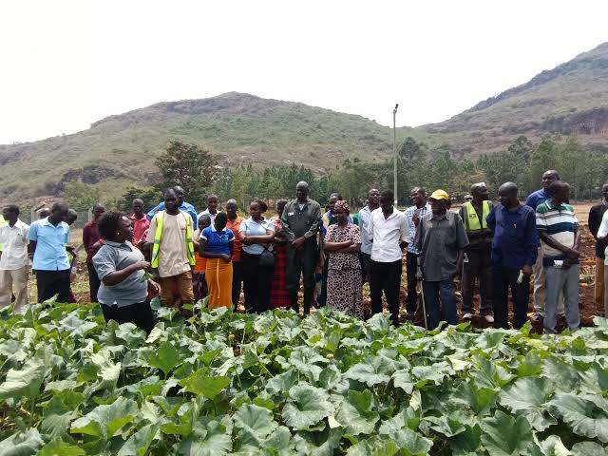
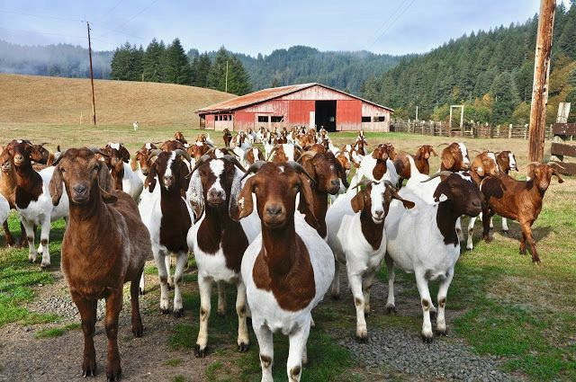
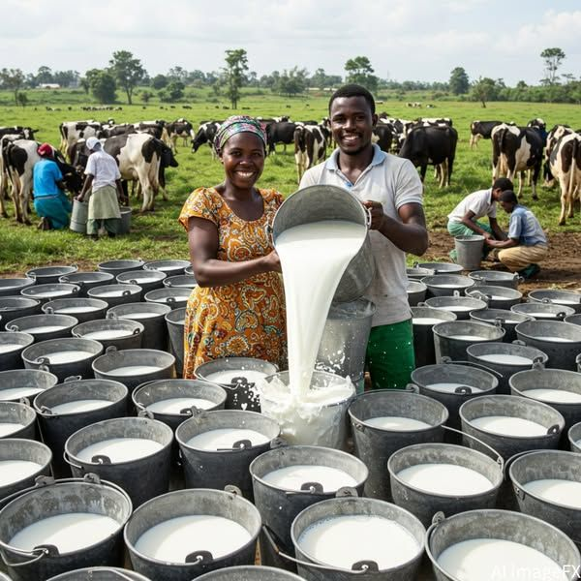
Value Proposition
SDG 2 Zero Hunger
SDG 13 Climate Action
SGD 9 Industry, Innovation & Infrastructure
Scalability & Future Plans
Expand detection to images and social media clips.
Mobile app version for offline use (ussd).
Integrate crowdsourced verification e.g. Community Notes.
Translate for local languages.
Social & Economic Impact
Enhances decision-making through trusted information.
Reduces the spread of agricultural misinformation.
Supports climate-smart and sustainable farming practices.
Builds community trust and resilience in digital agriculture.

Slide 6
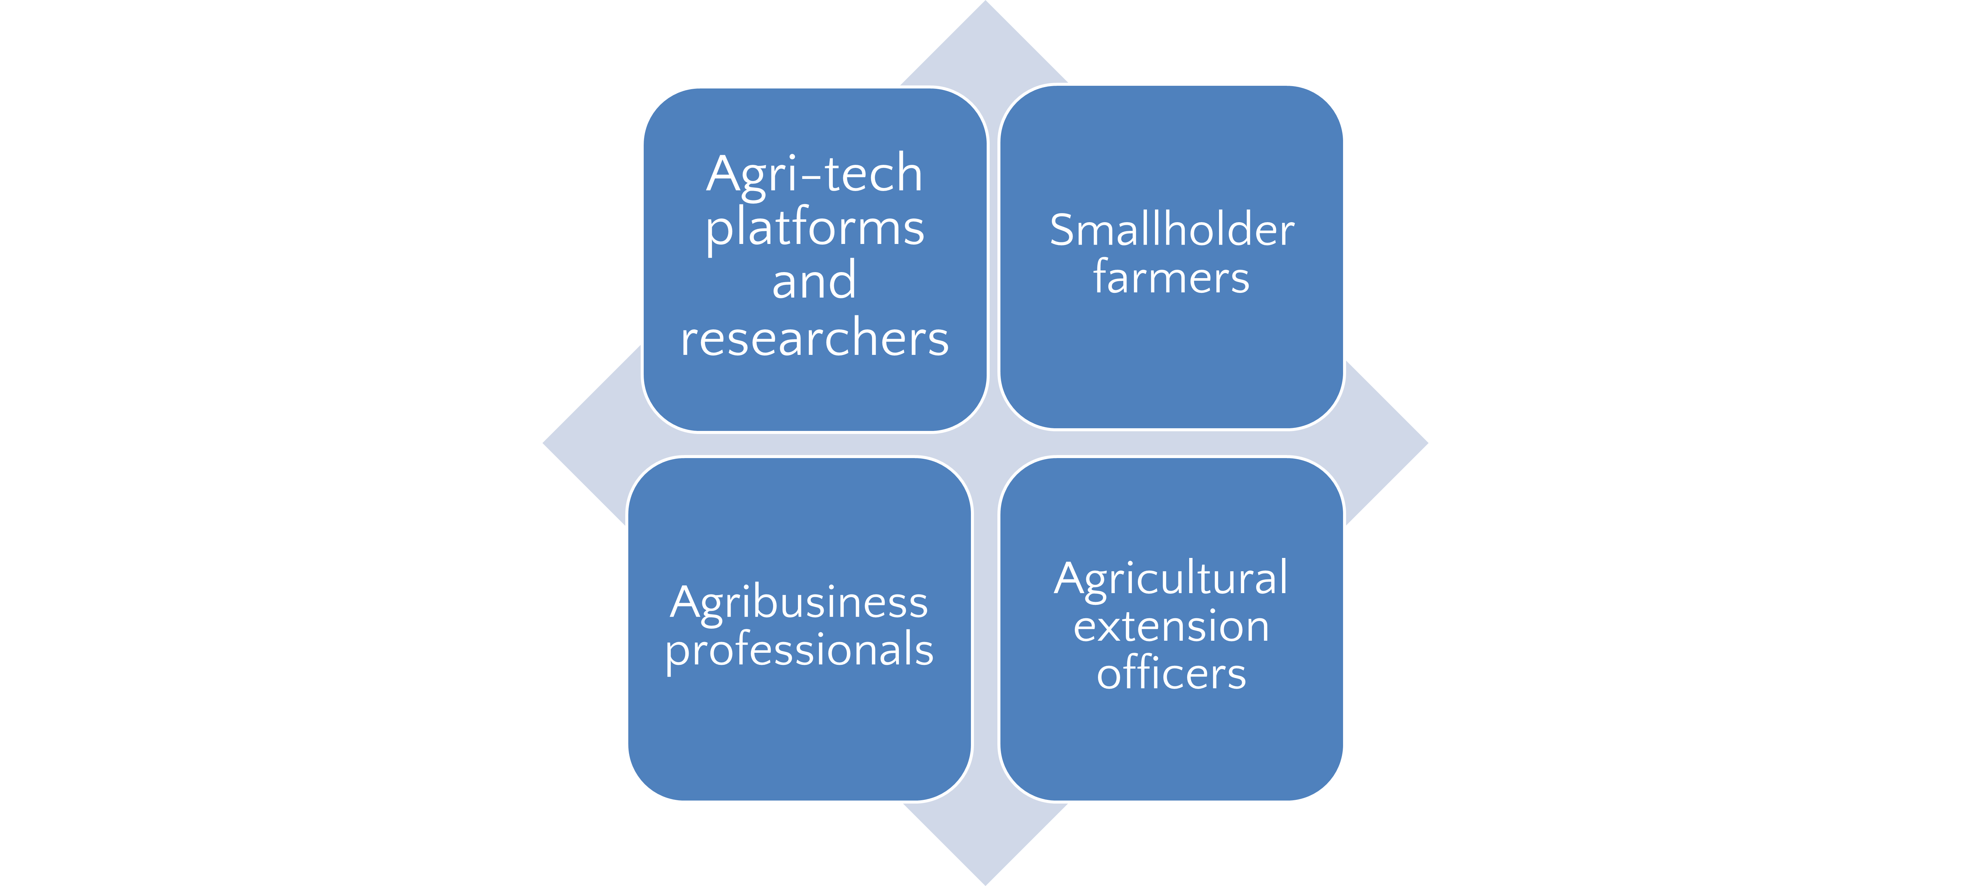
Market Landscape & Sustainability Model
Target Users:
Share Information
Use the platform tools
Validation of products
Real-time advice on fertilizers
Weather updates
Access to the platform & list their products
Use information from the platform for sensitization
Freemium model for farmers (basic access is free), Subscription, Contracts- B2B licensing (Government & NGOs), Partnerships

Slide 7
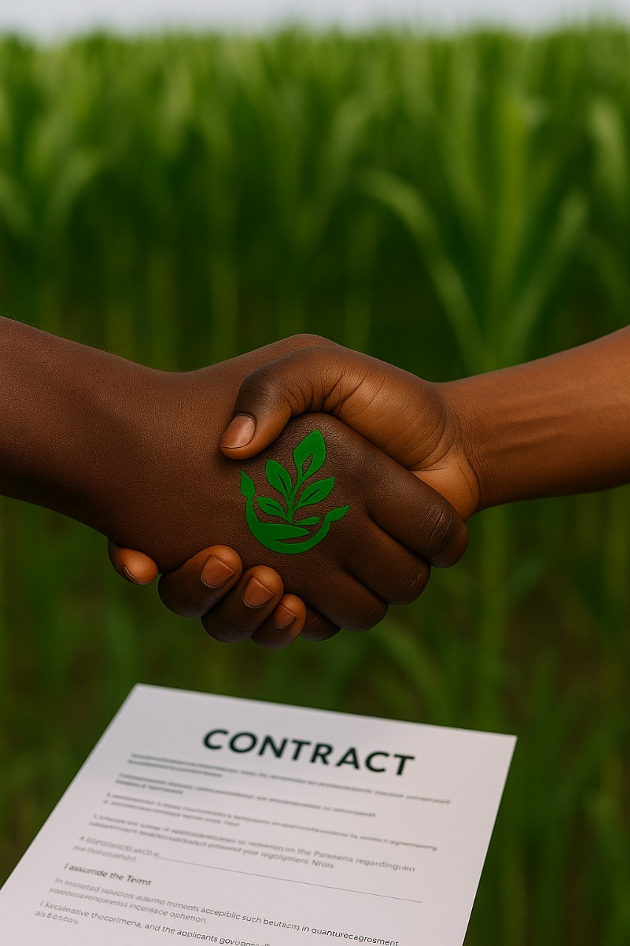

“He who has a mango tree in his yard receives more happy greetings during the mango season than ever” ~ African proverb.
Thank You
For Your Attention
Contact us
agrritrue13@gmail.com

